Slide 1
Navigating through the rough waters of standards
Laurent Romary, Inria

Slide 2
Objectives and overview of the week
From standards to lexical data
Mastering the basic standards for representing lexical data
The general standardisation background
Basics in horizontal standards: XML, Xpath, XSLT
The TEI guidelines: general principles, the dictionary chapter (and its most recent spin-off, TEI Lex-0)
Theory (a little) and practice (a lot)
Taken by the hand in XML/TEI encoding on the Oxygen XML editor
Slides and exercises available on: https://github.com/DARIAH-ERIC/lexicalresources
(Events/LSSL2022)

Slide 3
Overview of the cruise today
Standards – a general background
Introduction to XML
Practical session: going together through the principles of XML
Assignment: take a random dictionary entry from you favourite dictionary (online, at home etc.) and try to encode it in XML

Slide 4
ISO can save you from drowning!

Slide 5

Sailing is relaxing
Look here

Slide 6

Sailing is fun
Look here

Slide 7
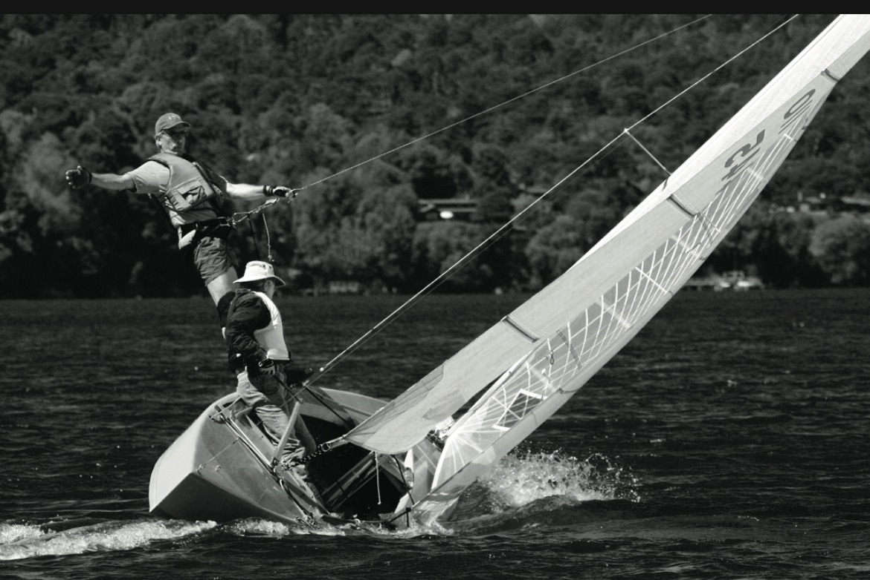
Really fun…
Look here

Slide 8

Up to a point…
Look here

Slide 9
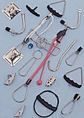
Issue
Trapeze
Harness + hook + wire attached to the upper part of the mast
Allows sailors to hang outside the boat
Keeping the boat flat: increase control of speed and craft
Incidents by sailing involving trapeze wires
Risk of being trapped underwater
Sailors must be able to detach themselves quickly at any time

Slide 10
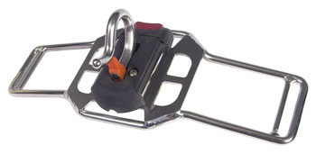
And here comes a standard!
Title: ISO 10862 Small craft – Quick release system for trapeze harness
ISO committee: ISO/TC 188: Small craft
Scope: ISO 10862:2009 specifies requirements and test methods for quick release devices as a component of the small sailing-craft trapeze system worn whilst afloat. The quick release device is intended to quickly release the wearer from entrapment and minimize the risk of drowning in the event of a failure to release from the sailing-craft trapeze system by other means.
The quick release device is intended to be easily accessible and operated in all conditions that might occur whilst in use, including when a craft is capsized or inverted.
Requirements and test methods to ensure the correct operation of safety release devices
Release time shorter than 5 sec.
Device operable with only one hand (and with full finger neoprene gloves)
Safety mechanism should not be released inadvertently
Note: In Europe, harnesses complying with the standard will bear the CE mark
RWO Trapeze Bar

Slide 11
Standards
What they are:
Reference background for the management of a technical process
Based on three pillars: consensus, publicity, maintenance
A constraint for each, a benefit for all!
Reading it, understanding it, implementing it…
What they aren’t
Something coming from nowhere… designed by standardisation committees, participating is always an option
Mandatory documents: common ground for a transaction
Regulations: unless a state or an international organisation takes it up
The need for Standards Developing Organizations (SDO)
Ensure that the three pillars of standardisation are in place
Standards are like the EU: you need to understand how they work to appreciate them…

Slide 12
Examples of standards development organizations (SDO)

Slide 13
ISO - International Organization for Standardization
Organisation (https://www.iso.org/)
Consortium of national members (standards bodies: DIN, AFNOR, Austrian Standards, IPQ - Instituto Português da Qualidade)
Technical committees, sub-committees and working groups
A large variety of technical domains (https://www.iso.org/technical-committees.html)
Standardisation process (cf. next slide)
Working Draft (WD), Committee Draft (CD), Draft of International Standard (DIS), International Standard (IS)
Business model
ISO standards have to be bought: the revenue finances the activity of the national member bodies and the central secretariat

Slide 14
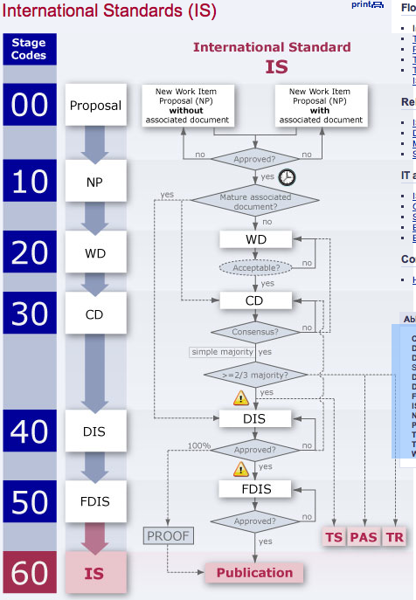
The ISO process
CD = Committee Draft
DIS = Draft International Standard
DPAS = Draft Publicly Available Specification
DTR = Draft Technical Report
DTS = Draft Technical Specification
FDIS = Final Draft International Standard
IS = International Standard
NP = New Work Item Proposal
PAS = Publicly Available Specification
TR = Technical Report
TS = Technical Specification
WD = Working Draft

Slide 15
Components of an ISO standard
Scope
Normative references
Terms and definitions
Actual constraints to be compliant to the standards
…
Note: An ISO standard is not a tutorial…

Slide 16
W3C - World Wide Web Consortium
Organisation (https://www.w3.org/)
Consortium of member organizations (mostly industrial companies, plus MIT, ERCIM (cf. Inria), Keio Univ., Beihang Univ.)
Development of standards for the World Wide Web
Ex. HTML, XML, XPath, RDF, OWL, SKOS
Standardisation process
Working draft (WD), Candidate recommendation (CR), Proposed recommendation (PR), W3C recommendation (REC)
Horizontal standards
Independently of a specific application domain (exception: MathML)
Business model
All documents are freely available, the private sector pays for it

Slide 17
IETF - Internet Engineering Task Force
Organisation: areas and working groups organized without any underlying administrative structure (https://www.ietf.org/)
“developing open standards through open processes”
Supported by the Internet Society
Centred on internet-based communications and interoperability: network protocols, identifiers etc.
Publication mode: freely available document
RFC – Request for Comment
BCP – Best common practice (stabilizes the knowledge accumulated over a series of RFCs)
Decision mode:
Sort-of crowd-sourced
Internet Assigned Numbers Authority (IANA): central coordinator for the assignment of unique parameter values for Internet protocols
Cf. language tags

Slide 18
The Text Encoding Initiative Consortium
Organisation (https://www.tei-c.org/)
Community based: institutional and individual membership
Develops standards for the representation of text-based documents
Standardisation process
2 releases per year of the TEI guidelines
Community feedback on GitHub
Triage and decision made by the TEI technical council
Vertical standardisation
Anything that has to do with text
Worked on infrastructural aspects by necessity (ODD)
Business model
All documents are freely available, the members pay for it

Slide 19
Standards at the service of interoperable IT systems

Slide 20

Standards for interoperability
“I am sending you a document compliant with ISO 8601”
“Received load and clear. I’ll check the standard to understand.”
“2022-07-04”
“Oh, you mean the 4th of July of year 2022 in the Gregorian calendar!”

Slide 21
So, what’s behind a data structure?
Standards do not come in isolation:
<quote xml:lang="fr-FR" xmlns="http://www.tei-c.org/ns/1.0">Demain, dès l’aube, à l’heure où blanchit la campagne…</quote>
How many standards do you see in this example?

Slide 22
Some basic standards
ISO 639, Codes for the representation of names of languages (multipart)
e.g.: fr, pt
ISO 15924, Codes for the representation of names of scripts
e.g.: Cyrl, Latn
Cf. sr-Cyrl or sr-Latn
ISO 3166, Codes for the representation of names of countries and their subdivisions (multipart)
e.g.: FR, PT, CA

Slide 23




Piling up standards
Text Encoding Initiative
XML and @xml:lang
BCP 47
IANA Language Subtag Registry
ISO 639 series (and ISO 15924, ISO 3166-1, UN M.49…)

Slide 24
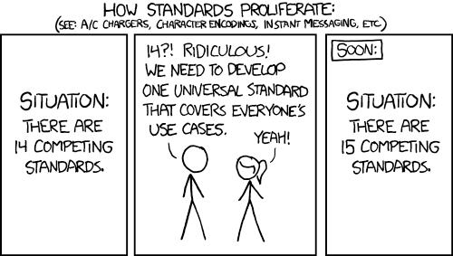
A wrongly good illustration

Slide 25
A typical case of standards bashing
We should not mix-up standards and idiosyncratic choices
Local practices may inform future international standardisation efforts: cf. Charles Goldfarb at IBM, the TEI and XML, etc.
Local practices may also reflect ignorance, political opportunism or the NIH (not invented here) syndrome
E.g. OLIF, the Open Lexicon Interchange Format
Streams of updated standards
From ISO 8879:1986 Information processing -- Text and office systems -- Standard Generalized Markup Language (SGML) to Extensible Markup Language (XML) 1.0 (Fifth Edition)
ISO/IEC 646, ISO/CEI 8859 series, ISO/CEI 10646 (OK, together with Unicode)
Standards also complement each other

Slide 26
A QUICK introduction to XML
But before anything serious starts…

Slide 27
A quick historical overview
1960’s — GML (Generalized Markup Language) by IBM
1970’s & 1980’s — ANSI initiates project to develop a Standard text-description language based on GML
1983 — SGML became an industry standard
1986 — SGML (Standard Generalized Markup Language) becomes an ISO standard: ISO 8879:1986
1987 — TEI (Text Encoding Initiative)
1990 — HTML 1.0 (HyperText Markup Language)
1992 — TEI edition P3 (Michael Sperberg-McQueen and Lou Burnard, eds)
1997/1998 — XML 1.0 (eXtensible Markup Language) (Tim Bray, Jean Paoli and Michael Sperberg-McQueen, eds)

Slide 28
XML basics
XML: eXtended Markup Language
A W3C (World Wide Web Consortium) Recommendation
W3C (www.w3.org) a consortium of industrial and academic members (see http://www.w3.org/Consortium/Member/List)
“Recommendation” = standard in the sense of the W3C
A meta-language: it allows one to define his own markup language
From cooking recipes to mathematical formulas
A simplified version of the SGML standard
SGML was intended to represent the “logical” structure of a document
HTML was conceived as an application of SGML

Slide 29
All you need to know about XML
XML as a serialization language
<gramGrp>
<gen>f</gen>
<num>p</num>
</gramGrp>
XML as a data model
Issues
Specifying structures: schemas
Providing semantics: documentation
Attributes, namespaces… and you’re nearly set
And the best quick reference you could think of: https://www.mulberrytech.com/quickref/

Slide 30
XML in the document processing workflow
Design
Edition
Transformation
Access
DTD/
Schema
Structures
XML
Data
Xpath - XSLT
Data processing, query
HTML
XHTML
User perspective

Slide 31
XML namespaces
Objectives: avoid conflicts between element and attribute names coming from various sources
Composite documents
XSLT instructions, Schema declarations
Declaration:
<doc xmlns:mml="http://www.w3.org/Math/MathML/"
xmlns="http://www.ua99.net/DOC/1.0">
<p>blah blah :
<mml:fn mml:definitionURL="mydef.xml">
…
</mml:fn> re blah blah</p>
<fn>As demonstrated in [Black and White, 64]</fn>
</doc>

Slide 32
Reserved namespaces
The xml: prefix is reserved by the W3C for specific attributes:
<p xml:lang="fr">…</p>
<entry xml:id="e25">…</entry>

Slide 33
Hands-on session – XML
Discovering the Oxygen editor
First steps through XML principles
Traversing an XML document - XPath

Slide 34
Should we/you be afraid of standards?
<cit>
<quote>Yes you should be afraid, but you should be more afraid of not having them</quote>
<author>Wendell Piez</author>
</cit>

Slide 35
For the long winter evenings
Laurent Romary. TBX goes TEI -- Implementing a TBX basic extension for the Text Encoding Initiative guidelines. Terminology and Knowledge Engineering 2014, Jun 2014, Berlin, Germany. 2014, Terminology and Knowledge Engineering, TKE 2014. <hal-00950862v2>
Laurent Romary, Andreas Witt. Méthodes pour la représentation informatisée de données lexicales/Methoden der Speicherung lexikalischer Daten. Lexicographica, de gruyter Mouton, 2014, 30. <hal-00991745>
Laurent Romary. TEI and LMF crosswalks. JLCL - Journal for Language Technology and Computational Linguistics, 2015, 30 (1), <http://www.jlcl.org>. <hal-00762664v4>
Laurent Romary. An abstract model for the representation of multilingual terminological data: TMF - Terminological Markup Framework. TAMA 2001, Feb 2001, Antwerp, Belgium. 2001. <inria-00100405>
Laurent Romary. Standards for language resources in ISO – Looking back at 13 fruitful years. edition - die Terminologiefachzeitschrift, Deutscher Terminologie-Tag e.V. (DTT), 2015. <hal-01220925>
…
https://cv.archives-ouvertes.fr/laurentromary

